Slide 1
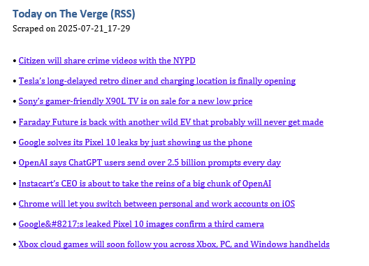
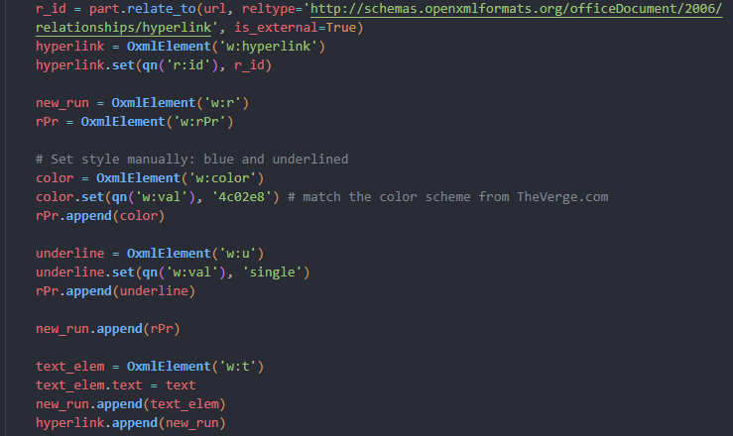
Verge-RSS-Scraper The News You Need, Delivered Instantly
Project Purpose
Automatically delivers the 10 latest headlines from The Verge.
Exports them to a Word document with clickable links.
Key Features
Current version replaces outdated HTML scraping with RSS parsing for consistent content delivery
RSS delivers reliable headline detection
Hyperlinked Word doc output for easy headline skimming
Tech Stack
Python
feedparser – for reading RSS feeds
python-docx – for generating styled Word documents
How It Works
Fetches RSS feed: https://www.theverge.com/rss/index.xml
Extract article titles and URLs
Outputs titles to a Word document with formatted, clickable hyperlinks generated from the URLs

